Slide 1
Usability Testing
Real techniques for assessing the usability of a design

Slide 2
Is there anyone in this whole wide world who is not familiar with the importance of software testing and all benefits that software testing brings? Today, it is simply unimaginable to release a product without thoroughly testing it. The risk is too high.

Slide 3
Usability
ISO 9241 (part 11) defines usability as:
“The extent to which a product can be used by specified users to achieve specified goals with effectiveness, efficiency, and satisfaction in a specified context of use”
…we could add learnability to this list.

Slide 4
Effectiveness:
Can you actually do a specified task?
Efficiency:
Can you do it quickly, without getting bored or frustrated?
Satisfaction:
Is it fun, or at least pleasant to use?
Learnability:
Can you use it without constantly reaching for the manual or asking for help.

Slide 5
Key questions
Usability evaluation should be considered at all stages of the design and implementation of an application. Meaningful evaluation involves the designer being able to answer some key questions:
Why are we testing? (e.g. to help us make design choices, to fix design mistakes? Or to test whether some users can complete typical supported tasks?)
When can we test? Pre-design, Initial prototypes, finished interface.
What are we testing for? (Effectiveness, efficiency, satisfaction, learnability)
What evaluation method is most suitable, given 1, 2 and 3 above.

Slide 6
Usability tests
Developed by Whiteside at DEC/Digital & Nielsen at Bellcore (Jacob Neilsen Usability Engineering. Academic Press, New York, 1992.) :
A procedure that critically examines the actual performance of a user involved in a communication process. Usability tests are conducted with end-users, ideally in their own environments, while performing real tasks.
Research conducted by Jakob Nielson has shown that as much as 85% of usability problems can be identified in the first usability test with a small group (less than 5).

Slide 7
Usability tests.
Usability testing reveals the problems real users experience with a product or web site under the actual conditions of use.
Participants are asked to carry out realistic tasks and inform where they experience problems.

Slide 8
Usability tests.
Nielson states that the best usability tests involve frequent small tests rather than a few big ones.
You gain maximum insight by working with 4-5 users and asking them to think out loud during the test.
As soon as users identify a problem, you fix it immediately (rather than continue testing to see how bad it is). You then test again to see if the "fix" solved the problem.

Slide 9
Usability Test: How?
Usability testing is not:
Link or load or code testing
Having friends / family view your pages on their computers
Online surveys or focus groups
Usability Tests:
Pick some important tasks and watch/observe how as people perform the tasks.

Slide 10
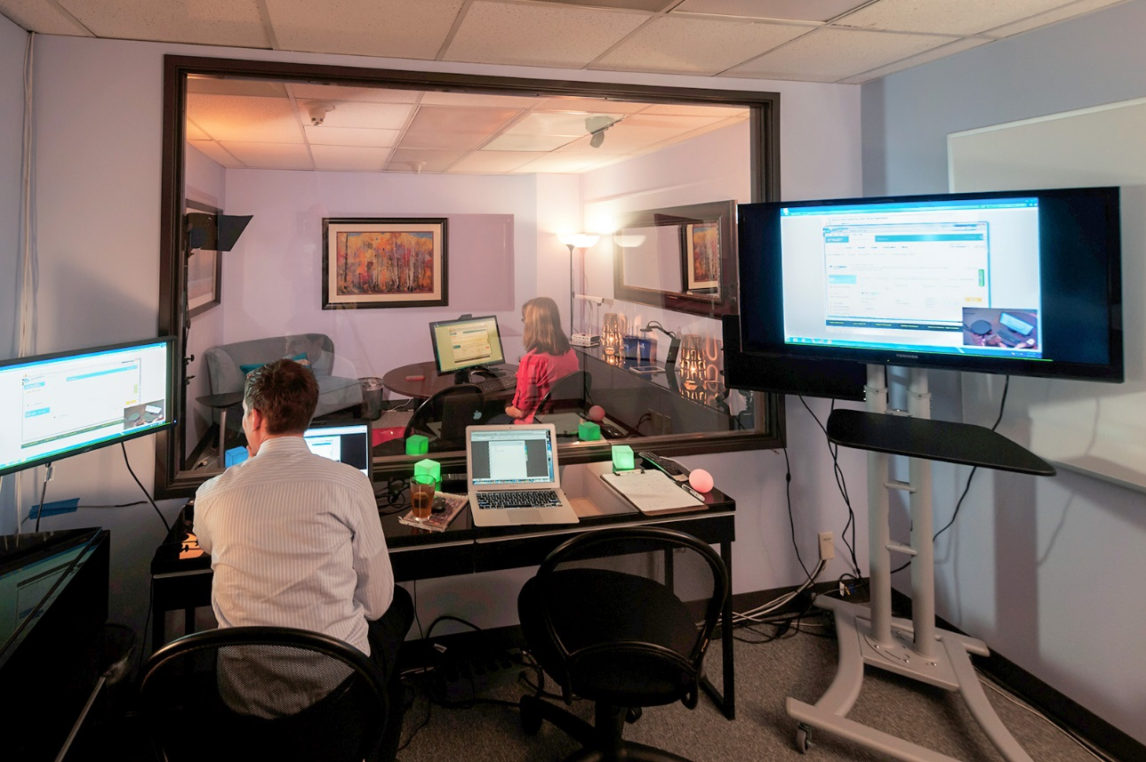
*“First-hand observation of your customer as they think aloud, can save you a dozen meetings later on.”
*”Usability testing in-person lets you see, hear and feel your users as they succeed and fail. This "direct experience" makes usability lab testing powerful”
*https://www.experiencedynamics.com/blog/2015/10/why-attending-live-usability-testing-essential-doing-good-ux

Slide 11
Key component of the test: realistic tasks!
The typical test consists of a subject at a workstation, or mobile phone, or tablet, or .... performing tasks while the experimenter observes the user and asks questions or provides prompts if necessary.
Tasks should be realistic and typical:
Example: A Way-finding system:
Please tell me the room number for Craig Stewart 106CR Module Leader?
In what room will I find the Computing course leader?
Is there an open access lab in this building?
Search for all staff whose last name begins with ‘S’
Notice how most of the tasks are posed as questions – Why?

Slide 12
Measuring usability –Example MEASURES:
Effectiveness
ratio of successes to failures (essential!)
Efficiency
time to complete task (if you are testing for efficiency)
Number of clicks taken compared to (known) optimum path.

Slide 13
Measuring usability –Example MEASURES:
Learnability
number of errors users make (helps locate the source of the problem)
Number of times user asks for help – or looks for help system (would be a disaster for our Way-finding system. Why?)
Satisfaction
User reviews the application against an expectation questionnaire taken before the test – “DID IT MEET YOUR EXPECTATIONS?”
number of times the user expresses frustration or satisfaction (satisfaction, indicates whether people will use the application in future)

Slide 14
How to Test for Usability
Plan
Do
Follow-up

Slide 15
Plan
Be aware of:
Purpose and audience of the site (likely user goals)
Most important usability criteria for this site (effectiveness, efficiency, satisfaction, learnability)
Tasks – what are users most likely attempting to do on the site. (planning for short duration tests / time issues)
Participants, scheduling, payment.

Slide 16
Do
Introduction for participant – explain of the test, setting the participant at ease.
Expectations questionnaire: explain purpose of the website ask the users their expectations about what the site should do (and not do) for them.
Introduce list of tasks (on paper? One at a time?)
Watch quietly
Record behavior (take notes, tape, screen recording)
Interact with participant if necessary
Debriefing, questionnaire, payment

Slide 17

Observation experiment: Turing tests in action
Turing’s imitation game: observation of Turing test judges during experiments
From 2014 Royal Society London experiments conducted by University of Reading:
https://www.youtube.com/watch?v=zgqetyY-_5U&feature=youtu.be

Slide 18
Follow-up
Tabulate data
Summarise your findings
Write down your design recommendations
Write down actions for the designers to take
Usability testing is a bit like ‘debugging code’. Think: what went wrong, where precisely did it go wrong, what’s the fix?
Write ups – should be complete enough for the test to be reproducible – include everything that you did in observing.

Slide 19
How formal should the test be? 1: Speedy
Schedule an hour worth of tasks
Convenient locations, realistic tasks
Users = anyone willing nearby
Debriefing very important: ask why questions

Slide 20
How formal should the test be? 2: Multipurpose lab space
Use any available space as laboratory-for-a-day
Bring in portable equipment
Laptop with a webcam and screen recording software

Slide 21
How formal should the test be? 3: Full usability labs
Build rooms just for this purpose
Adjoining, sound-proofed rooms
Video cameras, scan converters, two-way mirrors, microphones, etc
Cost: Up to £100,000
Do it all of the time to recoup investment

Slide 22
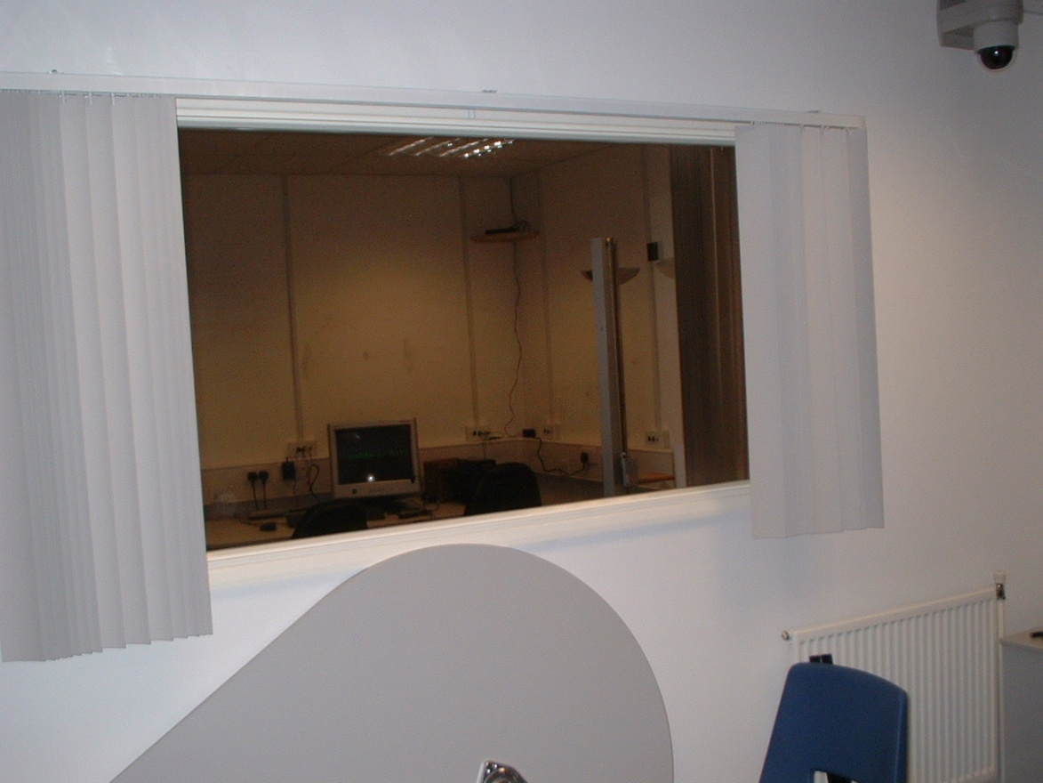
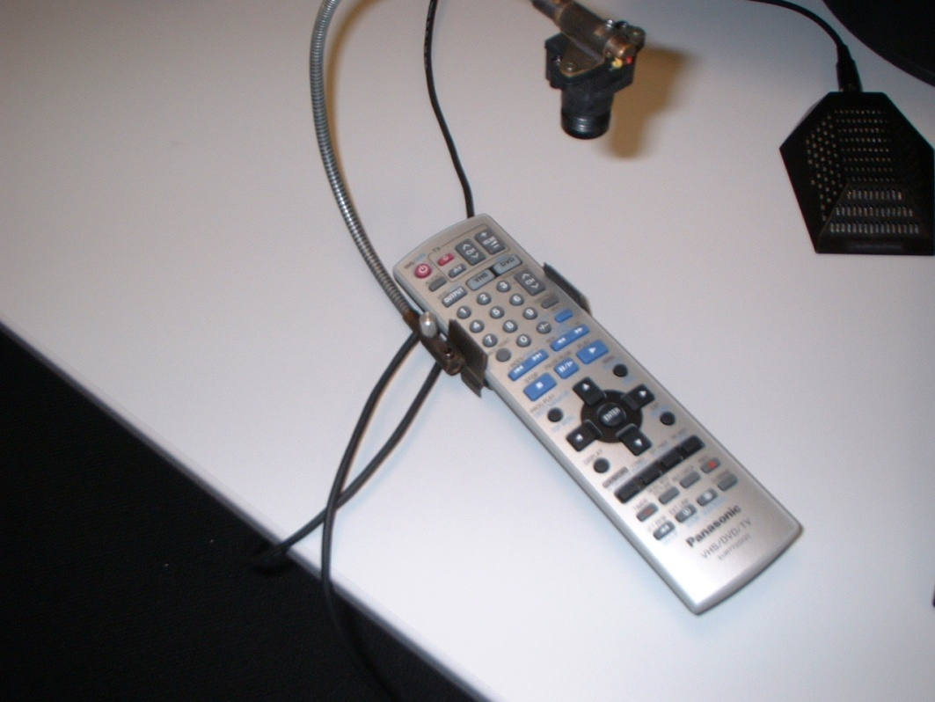
Coventry University Usability Lab

Slide 23
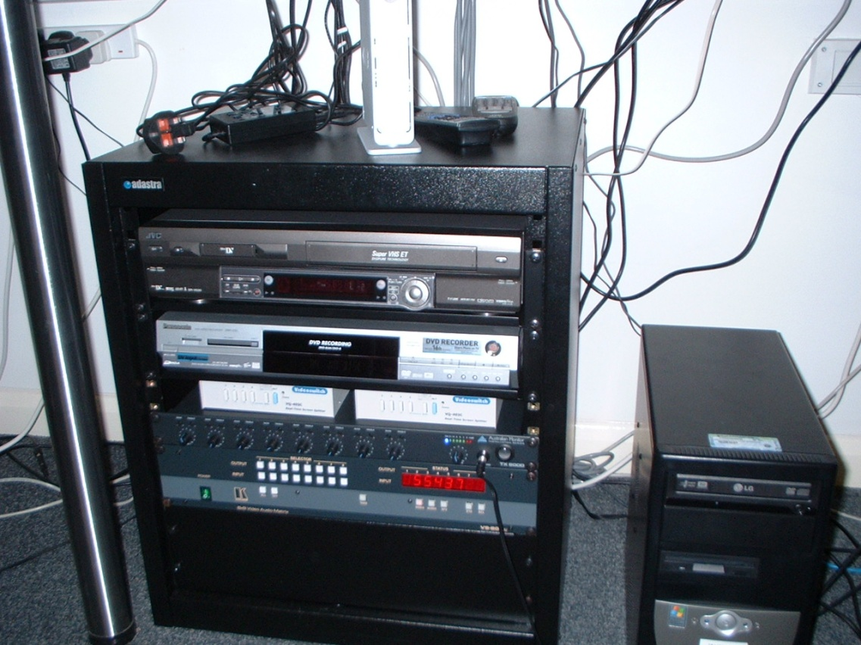
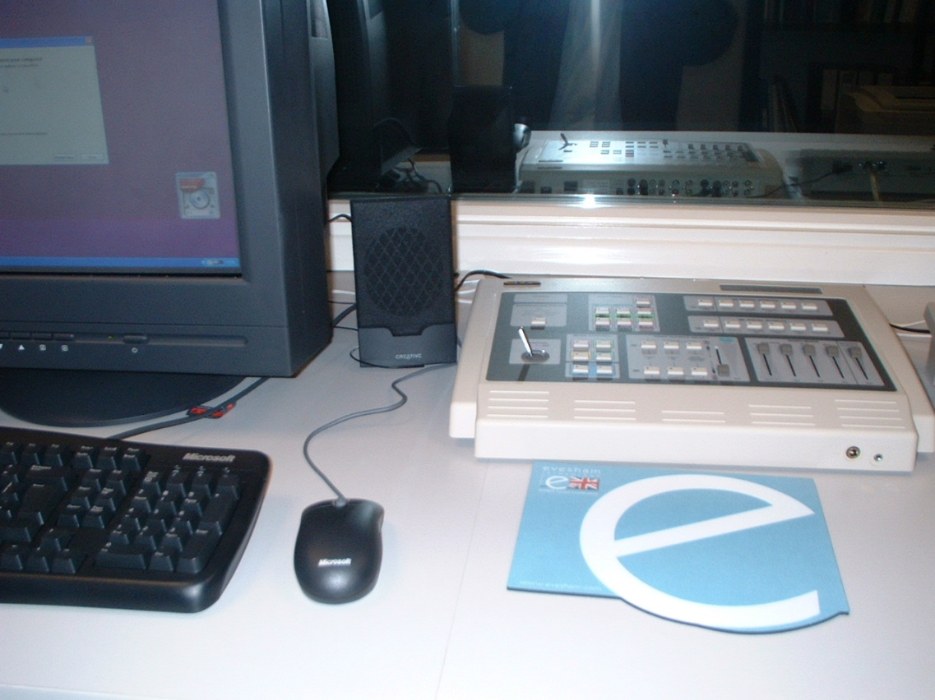
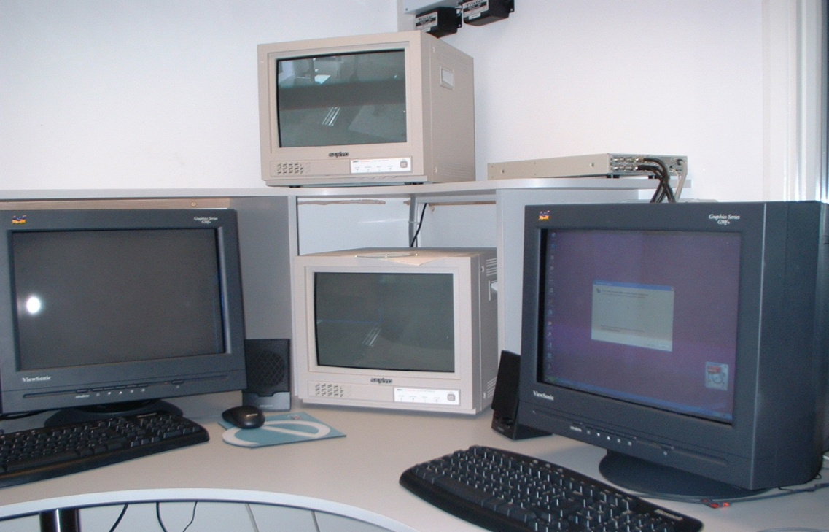
Usability Lab

Slide 24
Microsoft Usability Lab

Slide 25
Tips: Note-taking
Use screen printouts to scribble on (try this in the tutorials)
Words and body language as important as what users are doing on screen – you need to develop observational skills.

Slide 26
Tips: Participants think they are ‘dumb’, so:
Play dumb too: “I do not know how to do it either!”
Join the club: “Everyone else has had trouble too, so it is not just you”
Blame the designer: “If you are having trouble, then there must be a problem with the design”

Slide 27
Tips: Uses for video/audio tapes
Support note-taking with audio and video to remind you what happened
Review session with people who could not be there (video)
High-lights tape (very useful!)
Can sit on a shelf gathering dust

Slide 28
Tips: Recruiting users
Broadcasting does not always work
Friends of friends
Return participants
Find an organised group for a special audience (e.g., students from other schools, parents)

Slide 29
We’ve done the test, Now What? Analysing Usability Study Results
“Probably the best reason to test for usability is to eliminate those interminable arguments about the right way to do something. With human-factors input and testing… you can replace opinion with data. Real data tend to make arguments evaporate and meeting schedules shrink.” (Fowler, 1998, Appendix, p. 283)

Slide 30
Poor reporting
A usability test report has to be accurate and data driven to be of use to anyone
A big problem (in the world) as well as in student reports:
Ad-hoc usability problem reporting
Evaluators write down what they believe based on what they notice and what they are thinking at the time
Laundry list of raw usability problems
Inconsistent quality, vague, incomplete descriptions

Slide 31
Collecting data - Test materials
You may not realise it, but simply carrying out a couple of usability tests generates a huge amount of documentation and data
This means you already have plenty of content to put into a report
But also means that you must organising it well

Slide 32
Screening questionnaire
Provides user profile
Ascertains pretest attitudes and background information
Provides information about participants’ previous knowledge and experience
Orientation script
Describes the test to participants
Data logging materials / Screen capture videos
Data collection instrument for categorising participants’ actions (video / screen recorder / printouts & notes)
Task list
List of actions participants will execute
Desired end results
Motives for performing task
Actual observations to be recorded
State of system before/after

Slide 33
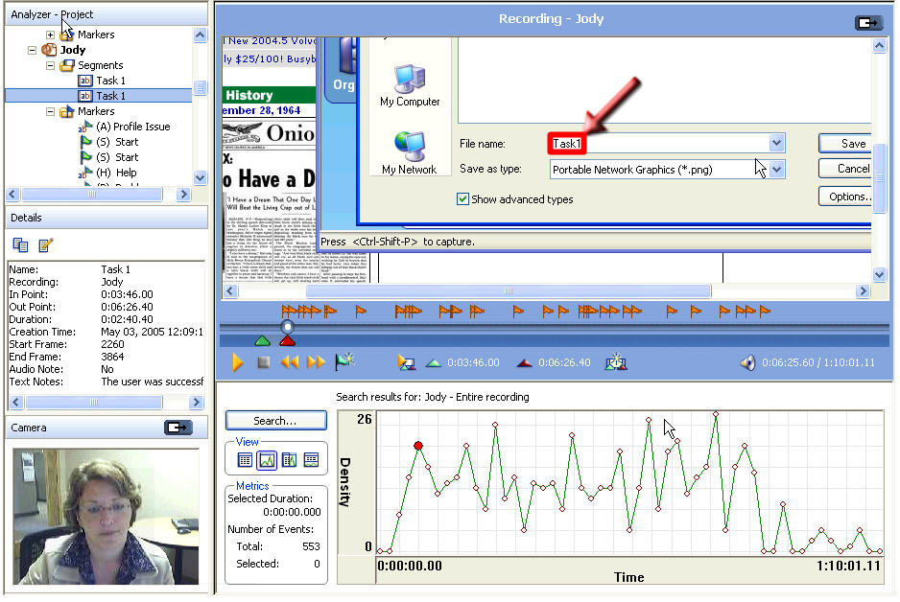

Slide 34
What about user satisfaction?
Post-test questionnaire
All participants asked the same questions (Why?)
Gather qualitative (text rather than numbers-quantitative) information and precision measurements
Use Lickert scale questions – scale that represents people’s attitudes to a topic

Slide 35
Example of Lickert scale question
Question:
Observation method in science is a compelling method to extract information on how things are done to find issues and design solutions
*Lickert scale responses:
Strongly Agree
Agree
Unsure
Disagree
Strongly Disagree
*From: https://www.simplypsychology.org/likert-scale.html

Slide 36
Analysis
Once data is collected we need to analyse it
Surprising how little analysis is done
What’s the difference between analysis and reporting?
Analysis = problem diagnosis
So what is the problem being analysed?
How the design fails to support user, NOT how user fails to cope with the design

Slide 37
Analysis – the data
Quantitative analysis
Four factors for benchmarking the usability of an interface (*Shneiderman and Plaisant, 2004)
Speed of performance
Time to learn
Rate of errors
Retention over time
Severity ratings
Time required to complete task
Number of users who encountered problem
Negative impact on users’ perception of the product
Interface is difficult to use if 70% of users cannot perform task (*Schneiderman, 2000)
*Shneiderman, B. & Plaisant, C. 2004. Designing the User Interface: Strategies for Effective Human-Computer Interaction, 4th Edition. Pearson Addison Wesley ISBN:0321197860
*Schneidermann, B. 2000. Universal Usability. Communications of the ACM, Vol 43, issue 5, p. 85

Slide 38
Analysis - the data
Qualitative analysis (not statistics)
Comments during the test
Notes from user debriefing
Questionnaire responses
Summarize findings / look for similarities in responses = Quantitative analysis
Triangulation: Do error rates (quantitative) and user comments (qualitative) concur with each other?

Slide 39
How reliable is the test analysis?
There are two specific limitations with usability test data.
The reliability limitation: Is the data reliable?
No, if you are testing users who are not typical of the true intended user group, or if there are significant individual variations within the test group (this is made worse by small sample sizes*)
The validity limitation: Are the conditions under which the data was recorded reproducible?
No, if the test is run differently each time (users briefed differently, different equipment used, not quite the same test questions asked)

Slide 40
Reporting: simple form CIF
CIF: common industry format:
https://www.usability.gov/how-to-and-tools/resources/templates/common-industry-format-cif.html
Executive summary
Main report
Describe the test method
Who, what, when, where, and how
Describe how tests were conducted
Profile users and describe sampling (are they the right users?)
Outline data collection methods / equipment
Succinctly explain the analysis
Provide screen captures
Include tables and graphs
Provide examples
Identify strengths and weaknesses of the application tested
Recommend specific improvements (actions)

Slide 41
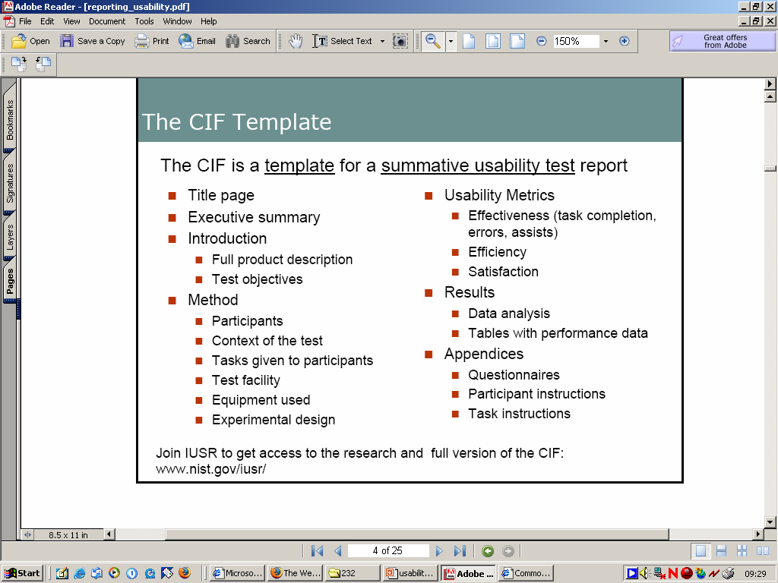

Slide 42
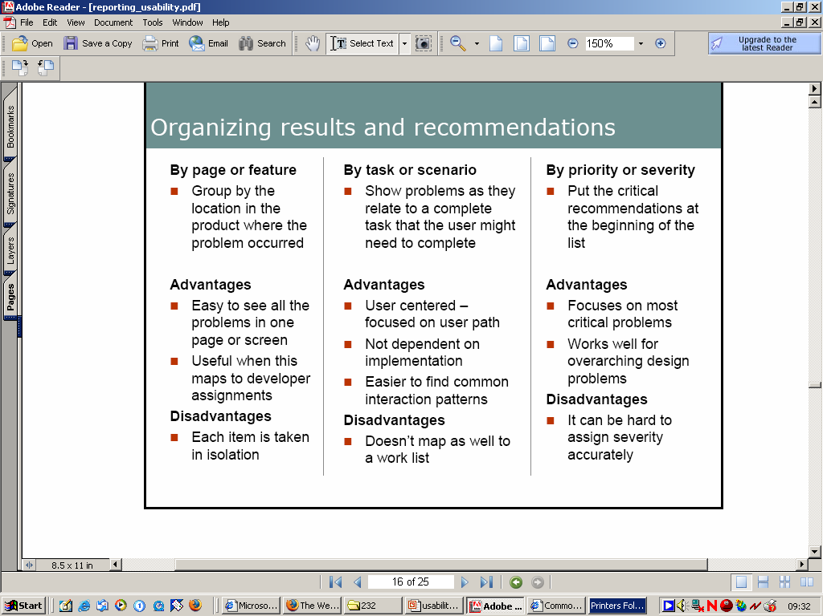

Slide 43
